Slide 1
Introduction to R Workshop
Robert Benirschke
July 23, 2023
Notes:
Hello everyone and welcome to this years Introducton to R workshop. I am Amrom Obstfeld the organizer of the course representing the presenters. We are so excited you have made the decision to take the time to join us and learn about R and how it can be used to power reproducible high quality data analysis and data science.
This workshop is designed for beginners who are brand new to R and new to coding in general. If you have some experience we're here to help you build up some R muscle memory, in addition to completely newbs we often see those looking for a refresher come back to take the workshop again, so welcome all.

Slide 2
Course Introduction
Notes:
I'm here just to give you a quick introduction after which we'll dive right into the meat of the workshop.

Slide 3
Goals and Objectives
Advocate for the use of R as a means of improving reproducibility in clinical data analysis
Demonstrate how R is used to perform analyses of laboratory operational data
Establish a basis of understanding in the 'tidy' approach to data analysis within the framework of R
Notes:
Obviously we would love for those who are here today to all walk away and just start coding but the reality is that while that would be great we also have a set of more modest if more important goals
We're here to Advocate for the use of R as a means of improving reproducibility in clinical data analysis and I cannot emphasize enough how strongly we feel about this point
As we review this we will demonstrate how we can use R perform analyses of laboratory operational data
And we also hope to establish a baseline understanding of what tidy data is and how to implement a 'tidy' approach to data analysis within the framework of R

Slide 4
September 26, 2021 | Session | Instructor
8:30 am - 8:45 am | Course Introduction | Robert Benirschke
8:45 am – 9:30 am | Intro to R and Reproducible Reporting | Amrom Obstfeld
9:45 am - 10:30 am | Coding Basics and Importing Data | Amrom Obstfeld
10:45 am – 11:30 am | Data Transformation | Robert Benirschke
LUNCH
12:30 pm - 1:30 pm | Grouping and Summarizing Data | Robert Benirschke
1:45 pm – 2:45 pm | Data Visualizations | Patrick Mathias
3:00 pm - 3:30 pm | Advanced Reporting | Patrick Mathias

Slide 5
Who are we?

Slide 6
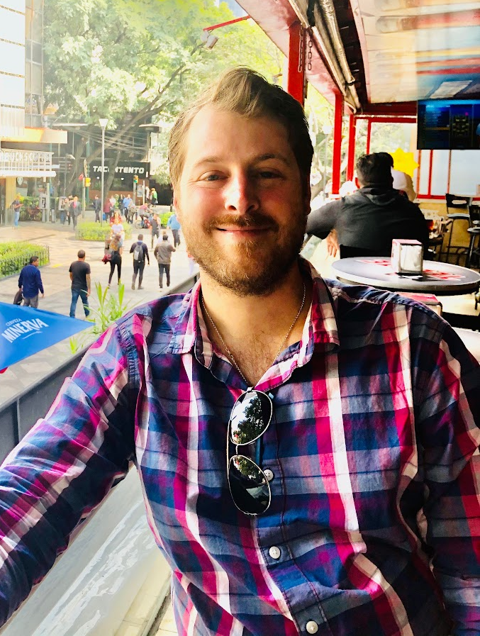
Robert Benirschke
Assistant Professor, University of Chicago, Department of Pathology (NorthShore)
Director of Core Laboratory and Point of Care testing
Director Clinical Pathology Informatics

Slide 7
Amrom Obstfeld

Slide 8
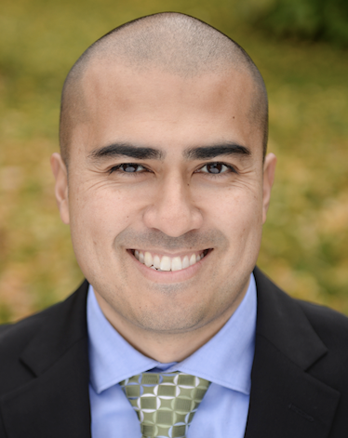
Patrick Mathias
Assistant Professor, Department of Laboratory Medicine and Pathology, University of Washington School of Medicine
Vice Chair of Clinical Operations
Associate Medical Director, Laboratory Medicine and Pathology Informatics
Notes:
Patrick Mathias, MD, PhD, is the Associate Medical Director of the Informatics Division in the Department of Laboratory Medicine at the University of Washington School of Medicine. His interests include developing data science and analytics as a core competency to improve clinical lab operations and laboratory stewardship, and applying clinical informatics approaches to mitigate laboratory-associated diagnostic errors. He is interested in developing and improving programming and data science education across all levels of pathology practice.

Slide 9
Workshop Workflow
Notes:
So now that you've met us let's discuss for a moment how this workshop is going to work

Slide 10
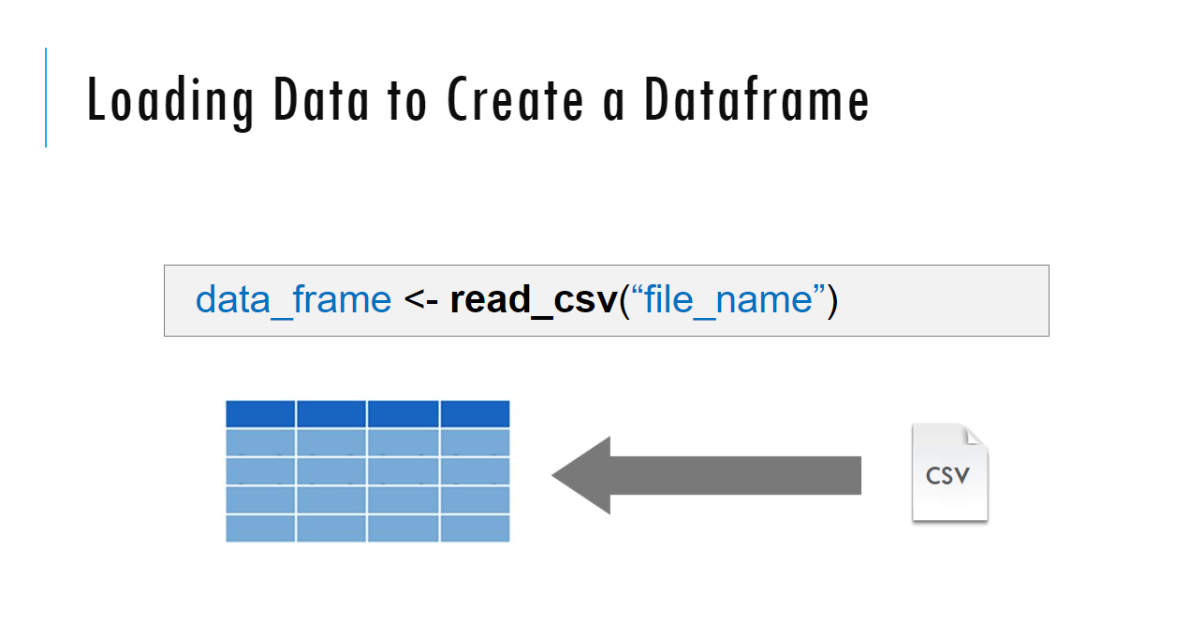
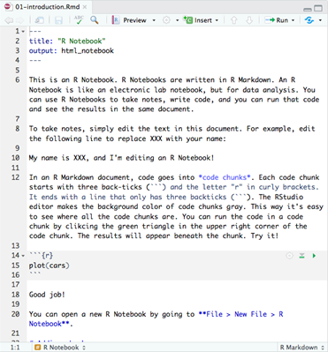
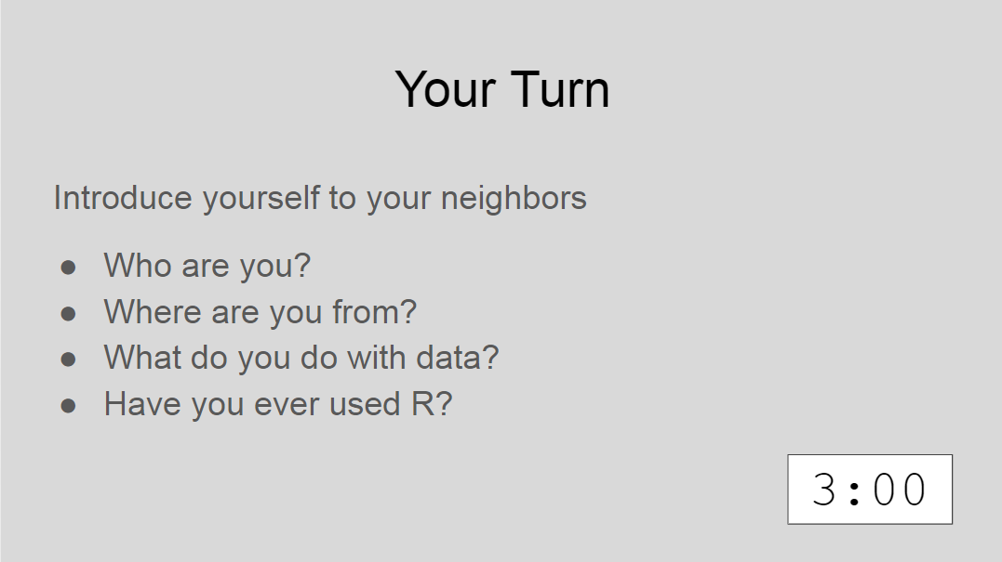
Sessions
Notes:
The meat of the workshop are the sessions each of which will cover discrete subjects or components of R in a data analysis. The sessions have a powerpoint associated with it as well as an R script.
We'll be describing a specific function or topic in the context of the powerpoint – all of which are included in the coursebook and available for download. The same code that is being demoed is included in the R script and you are invited to follow along, run the code, play with it if you like.
At several points in the session we'll have you engage in some exercises which we call Your Turns. In a Your Turn we'll assess how we're doing by asking you to critically think about the topic in the session and respond to a question or do some coding on your own. We'll speak a bit later about how these coding exercises will work.

Slide 11
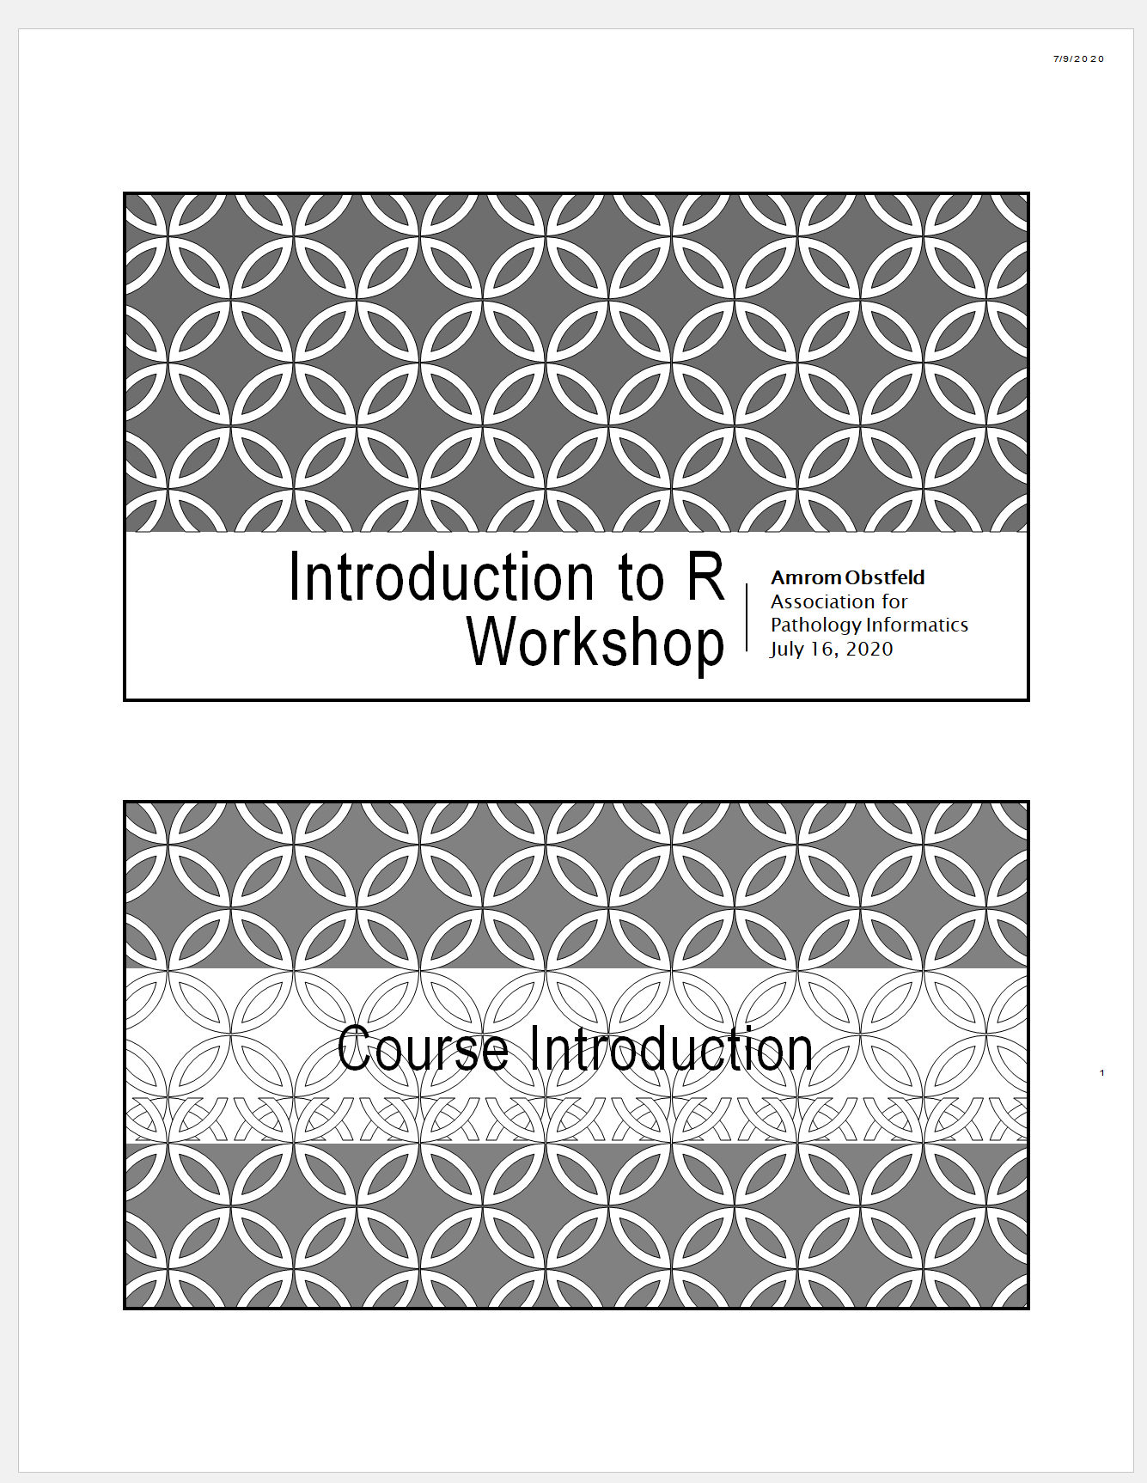
Workshop Coursebook
Coursepack folder on website contains:
PDFs for slides
Cheatsheets
Notes:
The coursebook has all the session powerpoints as well as an appendix that has some additional resources
Cheat sheets are concise one or two page documents that you can use as a quick reference. we'll be referring to these during the sessions. They are also easily googlable and available through the help menu in Rstudio. There is also a one page Useful resources document with links to free online resources like textbooks, videos and courses.

Slide 12
Getting Help – Remote lesson
Raise hand (literally)
In person and Slack support during exercises
Notes:
During the workshop sooner or later you’re going to need some help.
If you find yourself having a question or needing assistance during a presentation you have a few options.
If its pretty simple or as an initial pass you can drop it in the chat window.
You're also welcome to click the raise your hand icon and an instructor will send you a message and at that point you can try to work through the issue together and if need be you can jump into a breakout room with an instructor to get more intense help
There may be issues that are just too challenging to handle in the context of a virtual workshop. If that does occur we’re going to ask you to make a note of the issue, try to keep with the workshop, and hopefully we can find a way to take it off line.

Slide 13
Who are you?
Notes:
So, now that you've learned a bit about us and how this is all going to work, let's find out a little bit about you

Slide 14

Your Turn
Introduce yourself to the room
Who are you?
Where are you from?
Why are you here?
Have you ever used R?
Notes:
For our first Your Turn Nova will send us all into breakout rooms. You may need to manually click the join break out room button. Once you're there feel free to share who you are, where you are in training or what your position is in your organization, and what you hope to get out of this course.
After a few minutes Nova will call us back together and we'll finish up this intro session.

Slide 15
Tips for learning
Cheatsheets show how to do common things – orient yourself with them early (https://posit.co/resources/cheatsheets/)
The best way to learn to code is by doing
Practice is key!
Programming is hard, even for those with a lot of experience. Find resources and ask for help!
Notes:
And just some final words before we begin, no matter what you're learning but particularly coding, the best way to learn is by doing:
Find a project, make a goal for yourself, push yourself to use R, it's OK to lean on some excel, we all do when we're starting out, but try to get that activation energy to get your hands typing code. We would not be teaching this course if we didn't strongly believe that R is accessible to all of you. So keep practicing and you'll get there.
With that let's get started with the workshop. Up next Joe will provide us with the basics of R and get us up and running with Rstudio Cloud.

